Slide 1


Psychiatric genetics: why do it and where are we now?
Prof Martin Kennedy
Department of Pathology & Biomedical Science
University of Otago, Christchurch
Statistical Genetics Workshop
Plant and Food Research, Lincoln
10 April 2024
Notes:
OK with 20min each+questions (and we would ask if you are happy taking questions during the talk or at the end)?

Slide 2


Why?

Slide 3

Mental disorders have significant heritability
Notes:
Watson is familiar with the personal cost of mental illness. One of his sons, now in his 40s, has schizophrenia and continues to live with Watson and his wife because "he really can't take care of himself," the 85-year-old scientist said.

Slide 4
Comparative heritability of mental disorders
Heritability
Mental disorders
Other Important Familial Traits
20-40%
Anxiety disorders
Depression
Bulimia
Heart attack
Blood pressure
40-60%
Alcohol and drug dependence
Plasma cholesterol
Adult-onset diabetes
60-80%
Schizophrenia
Bipolar disorder
Anorexia nervosa
Weight
80-100%
Height
- -
Kendler (2003) plus Psychiatric Genomics Consortium updates
Notes:
Note these heritability’s known a long time!

Slide 5

How? Single nucleotide polymorphisms (SNPs)
We each have ~5 million SNPs
Over 600 million human SNPs catalogued (rsID, dbSNP)
SNPs can affect gene regulation or protein function
Very useful for mapping risk loci via association studies!

Slide 6
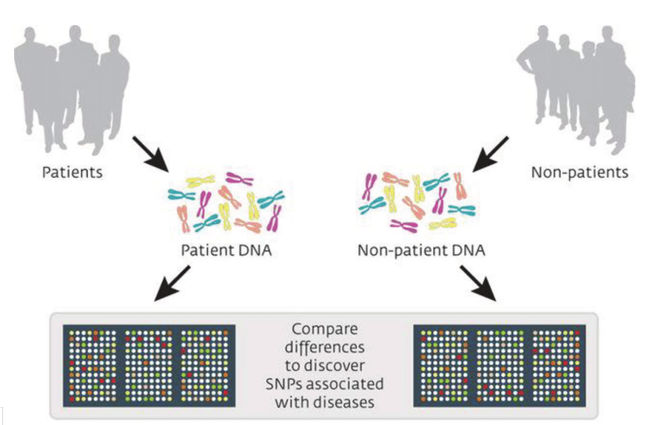
How? Genome-wide association studies (GWAS)
Cases
Controls
Notes:
Ask who knows about GWAS….
Don’t need to make guesses about candidate genes – this method is agnostic and simply generates a statistical signal that indicates regions of the genome associated with the trait under study.

Slide 7
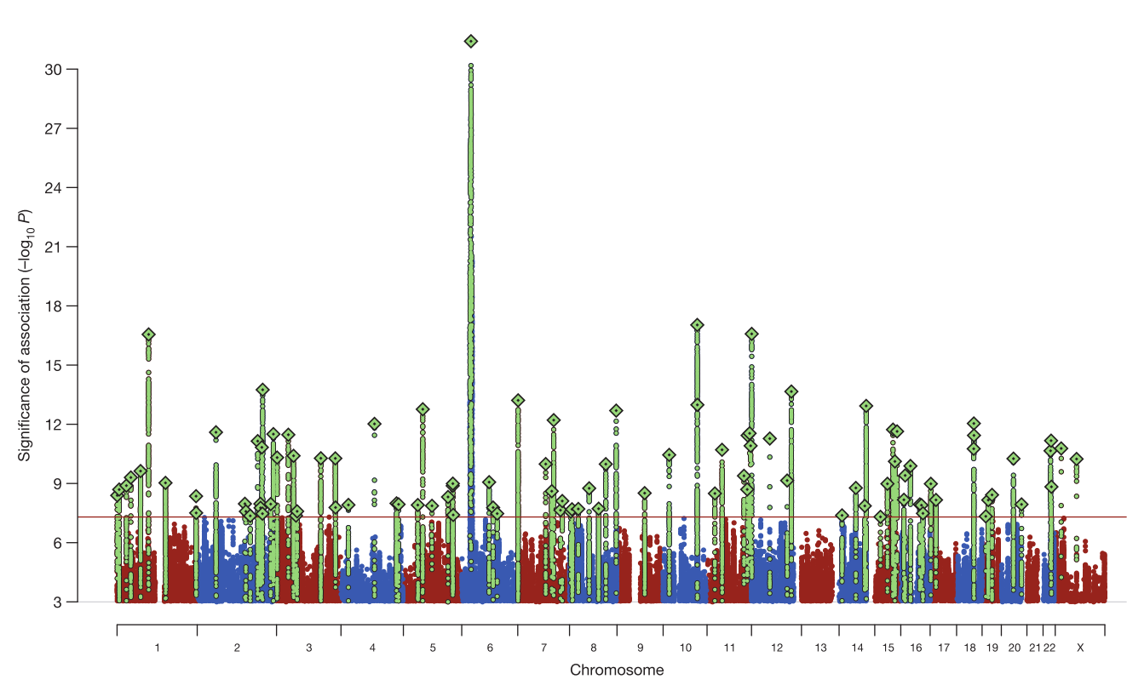

Genome wide association studies (GWAS)
37,000 cases
113,000 controls
Nature 511, 421-27 (2014)
Notes:
Now 145 loci known

Slide 8
GWAS progress to date – sample sizes
Condition | Cases | GWAS Loci
Schizophrenia | 67K | 270
Major depression | 250K | 102
ADHD | 143K | 80
Bipolar disorder | 30K | 30
Alcohol use disorder | 56K | 29
Anorexia nervosa | 17K | 8
Anxiety | 51K | 3
Post partum depression | 19K | 0
*
*
PGC Update, Sullivan, 2020; other papers
Notes:
ADHD https://www.sciencedirect.com/science/article/pii/S0924977X2300202X

Slide 9

What can we learn from GWAS data?

Slide 10
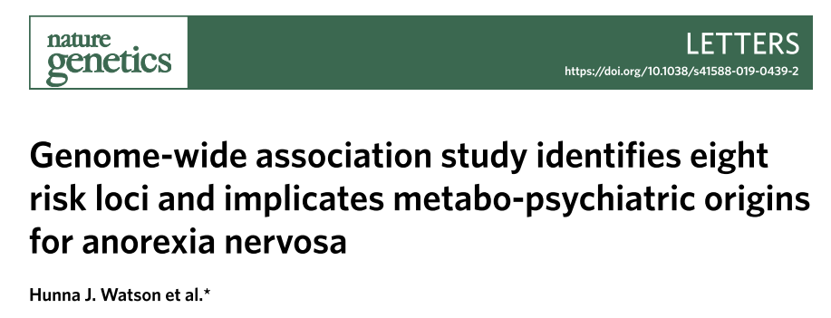


Anorexia nervosa GWAS as an example
Prof Cynthia Bulik UNC/Karolinska
Prof Nick Martin QIMR Berghofer
(2019)
Recruited 3414 Australians and 543 New Zealanders with anorexia nervosa
Largest cohort with anorexia nervosa ever collected in Australia and NZ
A/Prof Jenny Jordan
U. of Otago, Christchurch
>17K cases
>55K controls
Prof Martin Kennedy
U. of Otago, Christchurch

Slide 11
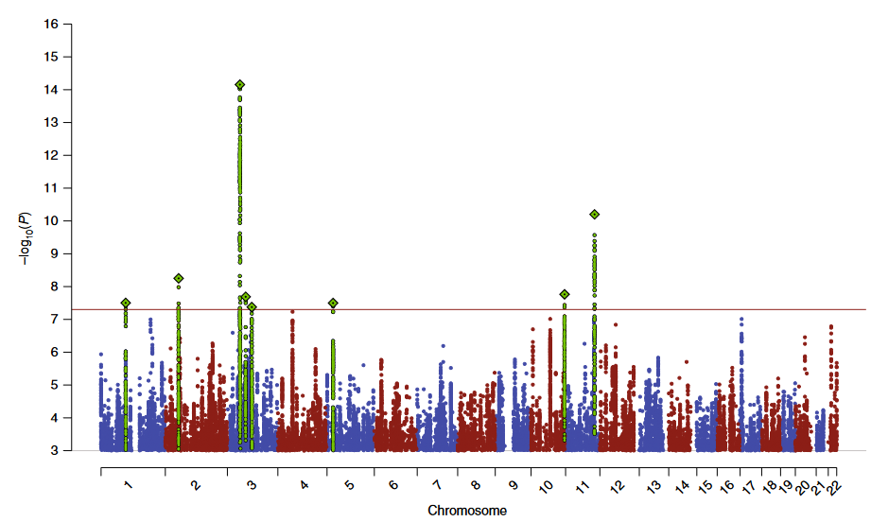
Anorexia nervosa GWAS (ANGI)
~17K cases
~50K controls
Watson et al. 2019

Slide 12
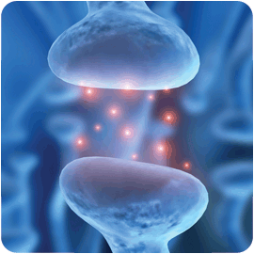
From genetics to biology
Notes:
Note that psychiatric genetics is about where cancer genetics was 25 years ago

Slide 13
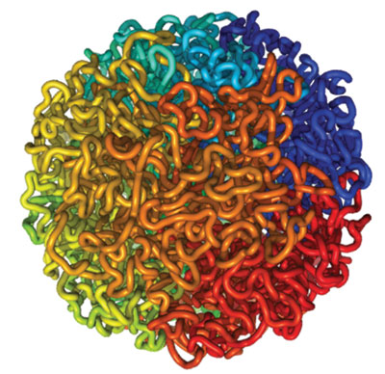
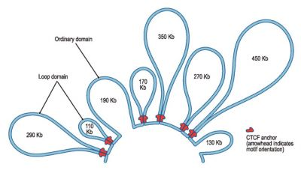
SNPs found by GWAS often regulate genes
>90% of GWAS hits (SNPs) are not in genes
Often fall within gene regulatory elements
Modify gene expression effects in specific cell types
Relatively small effects on risk (typically ~1.2-fold)

Slide 14
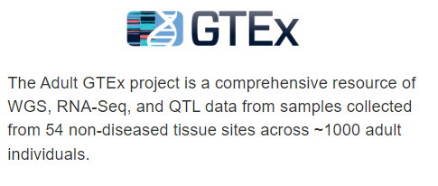
Anorexia nervosa GWAS: from genetics to biology
Some directly implicated genes and gene expression networks
Enriched for expression in brain tissues
Medium spiny neurons & pyramidal neurons from hippocampal CA1
Cell types previously linked to feeding behaviours
Notes:
The significant anorexia nervosa-associated loci implicated 121 brain-expressed genes, 74% by location, 55% by adult brain eQTL analysis, 93% by regulatory chromatin interaction and 58 genes by all three methods.

Slide 15
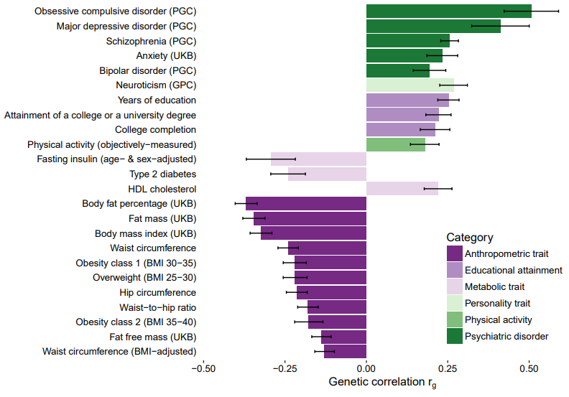
Genetic correlations of anorexia nervosa vs other traits
psychiatric
metabolic
Watson et al. 2019
Notes:
We observed significant positive SNP-r_{g} with educational attainment, but not with intelligence. Expanding previous observations (Duncan et al. 2017), we observed a palette of metabolic and anthropometric genetic correlations with AN unlike that seen in other psychiatric disorders.
Educational attainment (EA) is strongly influenced by social and other environmental factors, but genetic factors are also estimated to account for at least 20% of the variation across individuals¹. We report the results of a genome-wide association study (GWAS) for EA that extends our earlier discovery sample^{1,2} of 101,069 individuals to 293,723 individuals, and a replication in an independent sample of 111,349 individuals from the UK Biobank. We now identify 74 genome-wide significant loci associated with number of years of schooling completed. Single-nucleotide polymorphisms (SNPs) associated with educational attainment are disproportionately found in genomic regions regulating gene expression in the fetal brain. Candidate genes are preferentially expressed in neural tissue, especially during the prenatal period, and enriched for biological pathways involved in neural development. Our findings demonstrate that, even for a behavioral phenotype that is mostly environmentally determined, a well-powered GWAS identifies replicable associated genetic variants that suggest biologically relevant pathways. Because EA is measured in large numbers of individuals, it will continue to be useful as a proxy phenotype in efforts to characterize the genetic influences of related phenotypes, including cognition and neuropsychiatric disease.

Slide 16
From biology to better treatments
Repurposing old drugs
New drug targets
Notes:
Note that psychiatric genetics is about where cancer genetics was 25 years ago

Slide 17
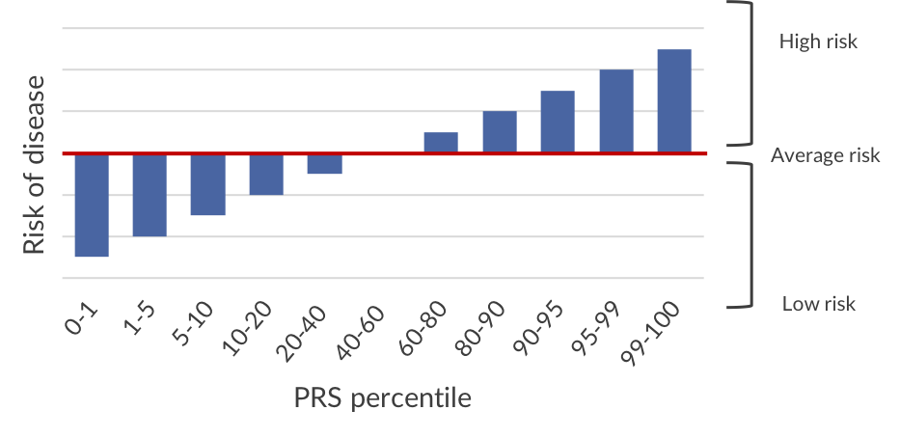
Polygenic risk scores

Slide 18

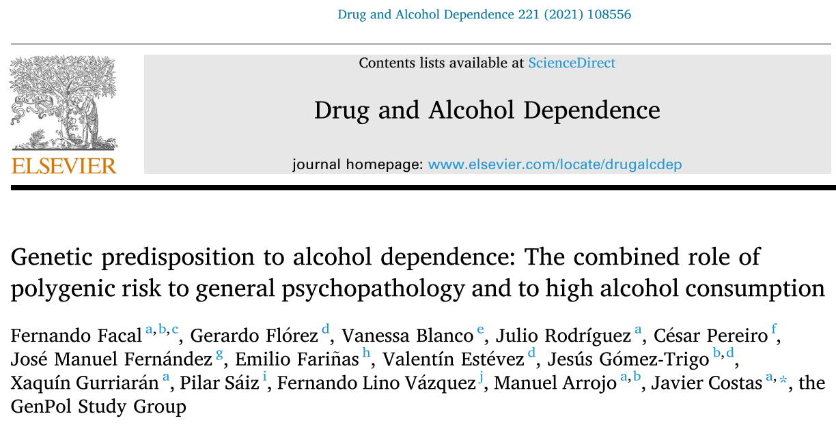
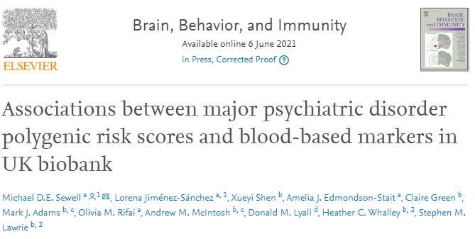
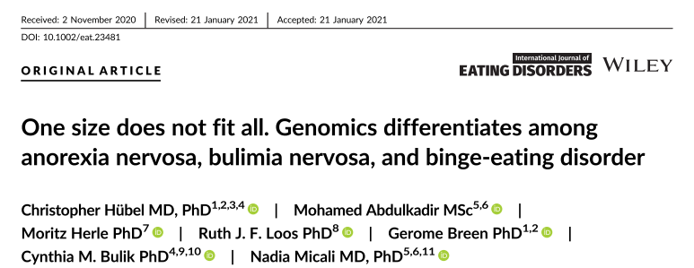

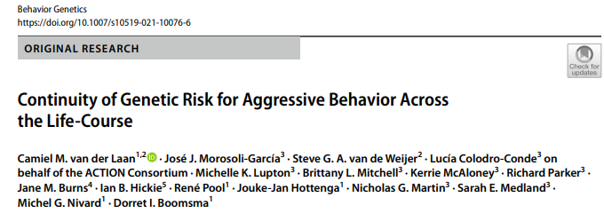
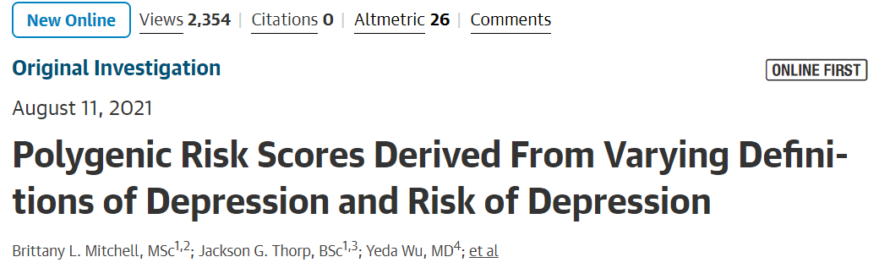
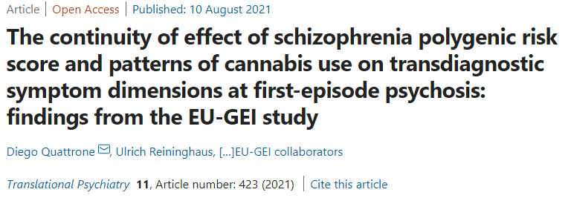
PRS in psychiatry: very active research area!

Slide 19
Genetic landscape of schizophrenia
Exome, WGS, family studies, aCGH
GWAS findings
Singh et al 2020 doi.org/10.1101/2020.09.18.20192815

Slide 20
Summary
GWAS data are giving insights into:
Genes and pathways that may be dysregulated
Cell types and tissues in which genetic risk impacts
Underlying biology and potentially druggable pathways
Relationships within and between traits and disorders
Polygenic Risk Scores:
Being widely explored but of uncertain clinical value
Rare variants (CNV and PTV) are important but they are rare
Genetic analysis is advancing understanding of mental disorders
All these analyses depend on good statistics & bioinformatics!
Notes:
Latest analytical proposal for PGC-ED Freeze 3 (April 2024)
LDSC on sumstats
CC-GWAS
GWAS by su
S-PrediXcan
Cell type analysis
MAGMA
PRS

Slide 21

https://www.genemappersconference.org/
Complex traits and diseases
Family studies and rare disease
Clinical translation of genomics
Genomics and indigenous populations
Functional genomics and multi-omics
Computational methods and new technologies
Biobanks and big data

Slide 23
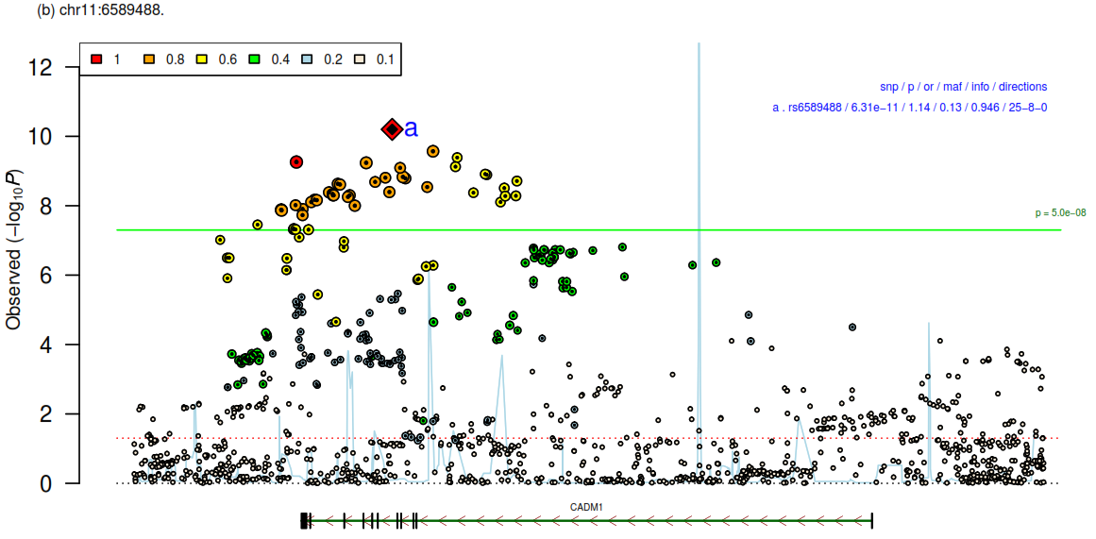
Anorexia nervosa GWAS (ANGI)
~17K cases
~50K controls
Watson et al. 2019

Slide 24

Psychiatric diagnoses
Image credit: Dave Cutler (artist).
Notes:
Watson is familiar with the personal cost of mental illness. One of his sons, now in his 40s, has schizophrenia and continues to live with Watson and his wife because "he really can't take care of himself," the 85-year-old scientist said.

Slide 25
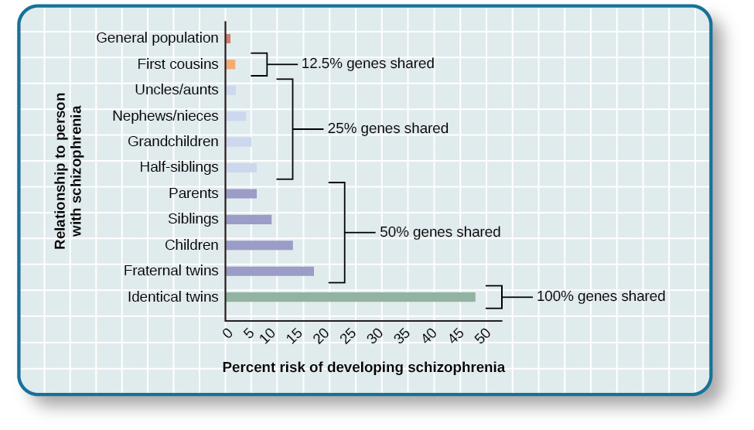
Schizophrenia and genetic risks in families
https://cnx.org/contents/fXTlbMdQ@3/Perspectives-on-Psychological-Disorders
Notes:
https://cnx.org/contents/7d74e56c-c750-4da5-a42c-50da0e5c5cb2@3/Perspectives-on-Psychological-

Slide 26
“The PGC is the largest consortium and the largest biological experiment in the history of psychiatry”
Notes:
Fellow of Royal Australian and New Zealand College of Psychiatrists
Dr. Sullivan is a founder and the lead principal investigator of the Psychiatric Genomics Consortium, the largest consortium in the history of psychiatry

Slide 27
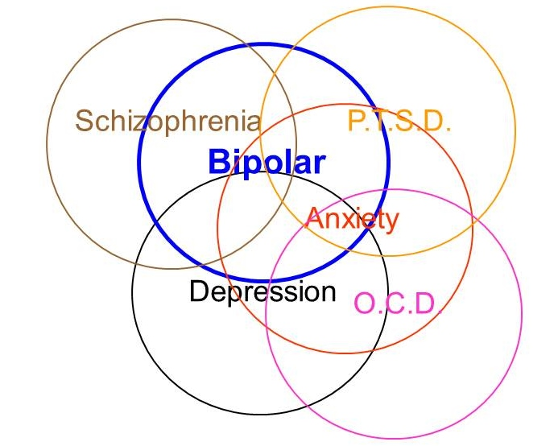
Genetic correlations across traits

Slide 28
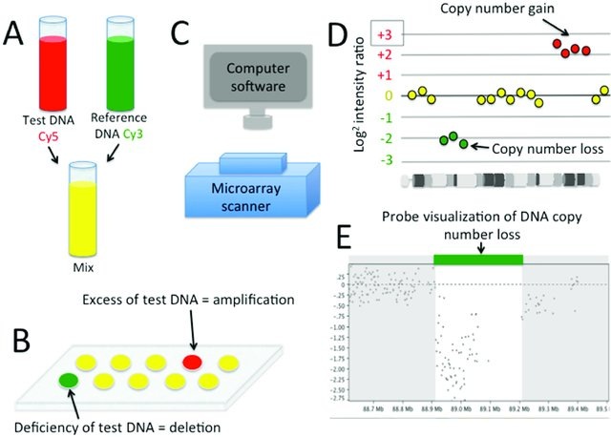
Rare structural genetic variants and psychiatry
Chromosomal microarrays (aka array CGH) + genotyping arrays
Quite a few rare syndromes due to structural genome variants (CNV)
Associated with schizophrenia:
1q21.1
2p16.3
3q29
15q11.2 (PWS)
5q13.3
16p13.1
22q11.2
Image from 10.3390/pathogens5010014
Cheap, high throughput
Costly, low throughput
Notes:
Define SV!!

Slide 29

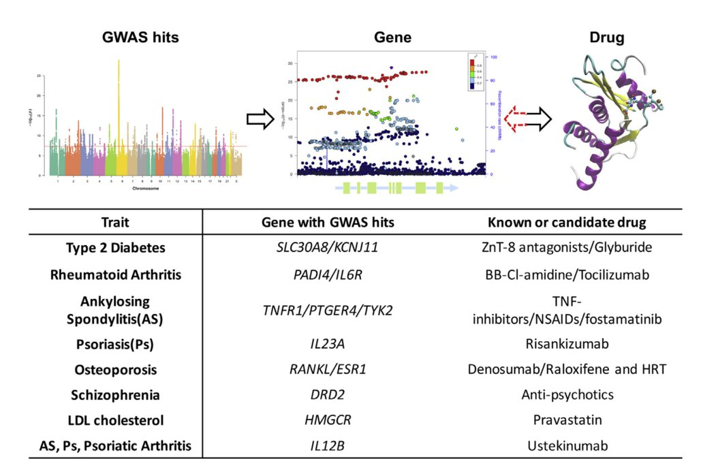

Drug development based on genetics
Anorexia nervosa: think about metabolic as well as brain targets
Visscher et al. 2017
PMID: 28686856

Slide 30
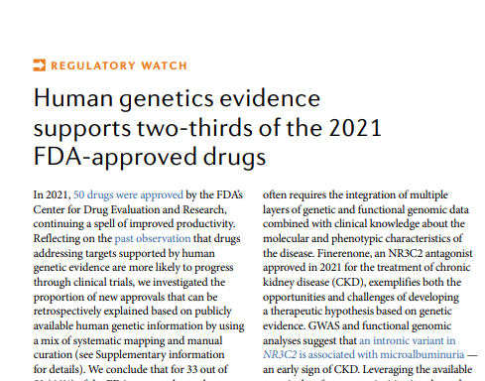
Genes and drug development
Drug development costs >US$1.2 billion
Projects with human genetics links had 2-fold > success rates in Phase II trials
75% of industry pipelines informed by genetics
For 33 out of 50 (66%) of the FDA-approved new drugs
in 2021 there is genetic evidence linked to their target
Robert Plenge 2019 ASHG
Notes:
Plenge: Drug development costs >US$1.2 billion
Old: preclinical models to identify leads
New: early discovery in human biology for leads
Projects with human genetics linked in gave 2 fold increased success rates in both Phase II and Iia trials
~75% of industry pipelines now informed by genetics
Drug development costs >US$1.2 billion
Old: preclinical models to identify leads
New: early discovery in human biology for leads
Projects with human genetics linked in gave 2 fold increased success rates in both Phase II and Iia trials
~75% of industry pipelines now informed by genetics

